Slide 1

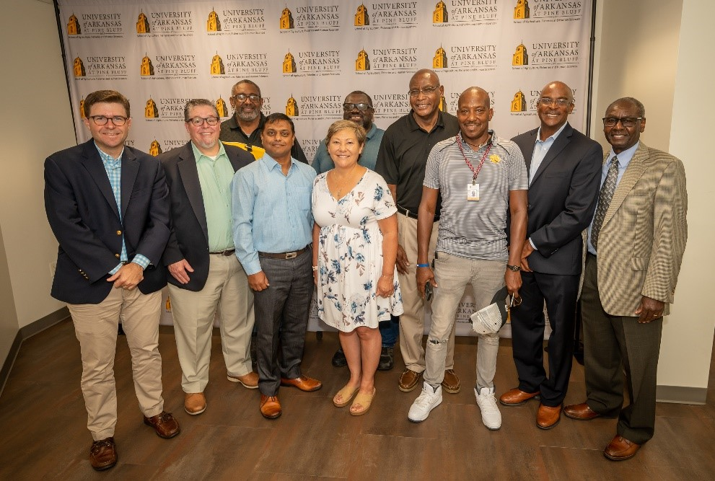
RMA Administrator Marcia Bunger with faculty from the
University of Arkansas at Pine Bluff – RME Funding Recipient

Slide 2
RME Partnership Program
  Risk Management Education Partnership Program provides funding annually to organizations to deliver education to producers, particularly historically underserved.
  Funded organizations include nonprofits, HBCUs, TCUs, and ag extensions among many others.
  Training covers a wide range of risk management subjects from financial planning and record keeping to legal resources and wildfire preparedness.

Slide 3
RME Partnership Program
The Risk Management Education (RME) Partnership Program is authorized under Section 522(d) of the Federal Crop Insurance Act (FCIA).
RMA is authorized to provide risk management education and training for producers through partnerships with public and private organizations.
Projects cover all major demographic groups, historically underserved producers, and organic operations.
Education provided covers a wide range of risk management subjects from financial planning and record keeping to legal resources and wildfire preparedness.

Slide 4
RME Partnership Program
  For FY 2023, RMA funded 24 projects for $6.5 million
    11 states, 10 regional, and three national projects
      Includes 20 awarded through a competitive Notice of Funding Opportunity (NFO) and 4 through direct awards
    A full list of awards can be found here: RME Partnership Program 2023 Projects | RMA (usda.gov)
  For FY 2022, RMA funded 18 projects for $5.5 million
    10 state, four regional, and four national projects
  For FY 2024, RMA has committed to funding up to 20 awards for $3 million through the annual NFO
  Next Notice of Funding – Early 2025 (FY2025)

Slide 5
RME Partnership Program
  Notice of Funding Opportunity
    Competitive process posted annually
    Includes Top Priorities and Agency Priorities
      Applications which include at least one priority area can earn higher scores through paneling process
      FY 2024 Top Priorities included: Climate Smart Ag, Equity and Opportunity for Historically Underserved Producers – i.e. Local Foods and Urban Agriculture, Organic and Specialty Crops, and WFRP/Micro Farm
        Other Agency Priorities include: All Livestock Products, Crop Insurance 101, Double Cropping, Rainfall Index Insurance – i.e. PRF, Annual Forage, and Apiculture
      Audience emphasis is on U.S. producers and ranchers and should specifically reach out to producer types not normally reached, such as limited resource and underserved producers.

Slide 6
FY 23 Partners by Priority Area:
RME Partnership Program
  Provide education on the fundamentals of crop insurance:
    AgriLogic Consulting, LLC, Iroquois Indian Tribal Confederacy, Inc, National Crop Insurance Services, Rural South Institute, University of Connecticut
  Provide special emphasis on climate risk management:
    Farmer Campus, Montana State University, Napa Valley Grapegrowers
  Provide special emphasis on livestock:
    Society for Range Management, University of Nevada, Reno
  Provide special emphasis on assisting limited resource producers, including urban agriculture, organic and specialty crops:
    Annie’s Project, Center for Rural Affairs, Clemson University, Crosshatch Center for Art & Ecology, Iowa Organic Association, Michigan Food and Farming Systems, National Crop Insurance Services, North-South Institute, Seven Rivers Resource and Conservation Development Council, The Gleaning Network of Texas

Slide 7
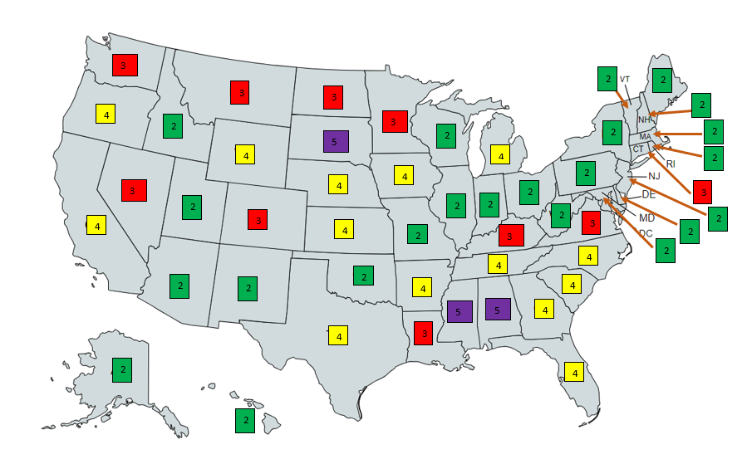

RME Partnership Program
  2023 Cooperative Agreements by State
NOTE: One agreement could cover multiple states
2 agreements
3 agreements
4 agreements
5 agreements

Slide 8

Pilot Programs
  METAPHASE – Grant Applicant Assistance
    5-year pilot with a $4 million cap available to NRCS/FSA/RMA for grant applicants from historically underserved organizations and communities
    Provides the educational town halls, technical writing support and project management assistance

Slide 9
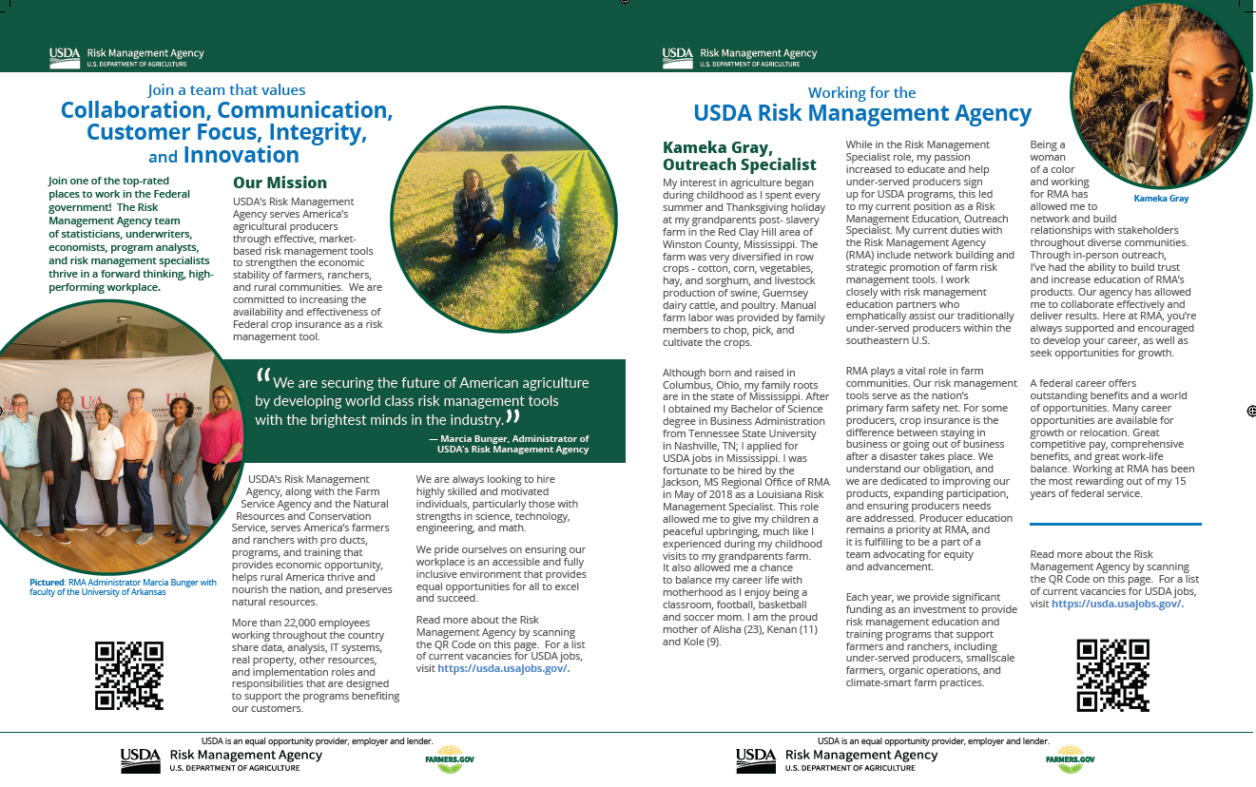
DiversityComm
DiversityComm
Five-year Blanket Purchase Agreement (BPA) available to NRCS/FSA/RMA
Bimonthly advertisements, $60K/year reaching millions via national publications
Promotes RMA endeavors, diversity and employment opportunities

Slide 10
Navigators
    University of Arkansas - Southern Risk Management Education Center
  2-year pilot project funded FY2022 through a direct award of $1.4 million.
  In collaboration with the University of Arkansas System Division of Agriculture (UADA), a pilot project strengthening outreach and technical assistance to farmers and ranchers through the development of risk management Crop Insurance Navigators.
    The objective is to enhance understanding and use of federal crop insurance by producers historically underserved by the crop insurance sector.
    Proposed effort to serve southeastern U.S. - Alabama, Arkansas, Georgia, Florida, Kentucky, Louisiana, Mississippi, North Carolina, Oklahoma, South Carolina, Tennessee, Texas and Virginia.
    Formal collaboration of educators with RMA strengthens the Extension educator network and allows for efficient sharing of crop insurance resources and best management practices. The network will also allow for timely communication to educators and ultimately to farmers and ranchers through the trusted network of Extension educators and community organizations that are already connected with the land-grant entities.

Slide 11

Navigators
Project activities seek to:
• Leverage the land-grant system agricultural economist to enhance the collaborations,
resource development, and outreach on crop insurance products and services,
• Build awareness and/or understanding of the network of Approved Insurance Providers
(AIPs) operating across the region with a focus on actively connecting the AIPs with
targeted producer groups and academic institutions,
• Connect with outreach educators—including 1862 farm management committees, 1890 Small Farm Programs (2501 programs), and USDA Liaisons—to enhance level of crop insurance outreach to historically underserved farmers and ranchers,
• Serve as outreach and engagement specialist working to promote the programs, products,
and services of crop insurance stakeholders—RMA, National Crop Insurance Services, and
AIPs. Activities include collection of customer service data and stakeholder feedback as
well as analysis of crop insurance industry metrics in order to improve sector performance
measures.
For more information on the project visit
Crop Insurance Navigator (uada.edu).

Slide 12
RMA SE Ambassador
    CA Elliott, LLC – Dr. Cindy Ayers - Elliott
  1-year partnership funded FY 2023 through a direct award of $250k. Targeting the following states within the southeast U.S: Alabama, Arkansas, Florida, Georgia, Kentucky, Louisiana, Mississippi, North Carolina, Oklahoma, South Carolina, Tennessee, Texas, Virginia
  The RMA SE Ambassador Project is a strategic initiative designed to strengthen RMA's outreach, engagement, and impact within the agricultural community through leveraging the expertise and passion of a selected individual to enhance RMA's presence and mission.
  The primary objectives of the RMA SE Ambassador Project are:
    Promote RMA programs, financial, and risk management tools to underserved farm communities.
    Foster stronger relationships between RMA and its stakeholders.
    Drive participation and awareness of RMA programs for Small to Mid-Size Farms, Urban Ag, and Specialty Crop producers.
    Assist RMA in gathering data related to program effectiveness, stakeholders needs, and regional challenges.

Slide 13
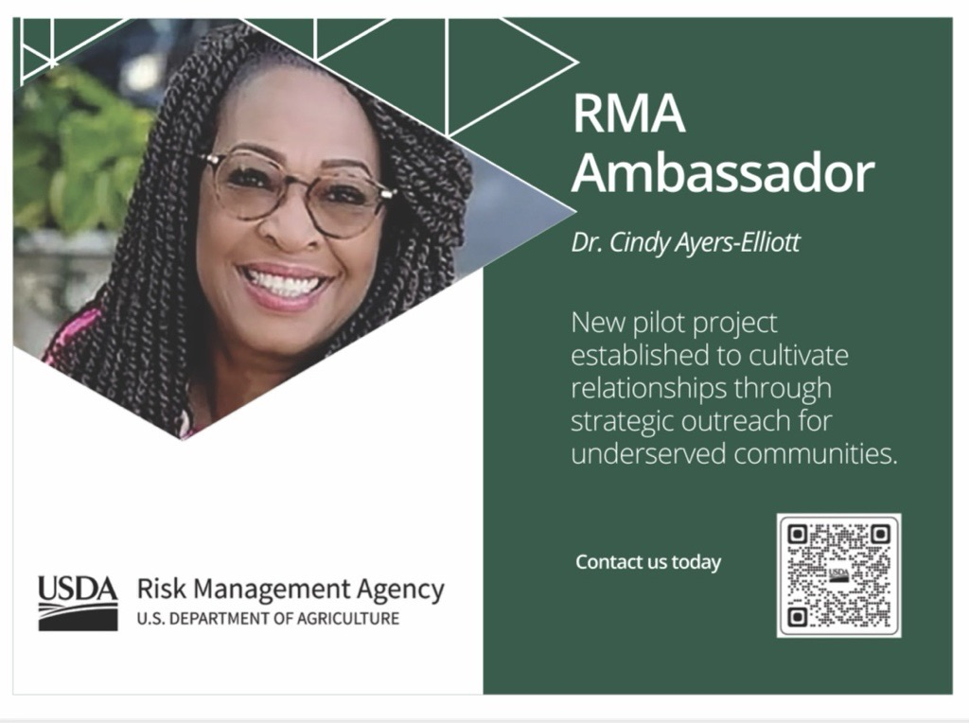
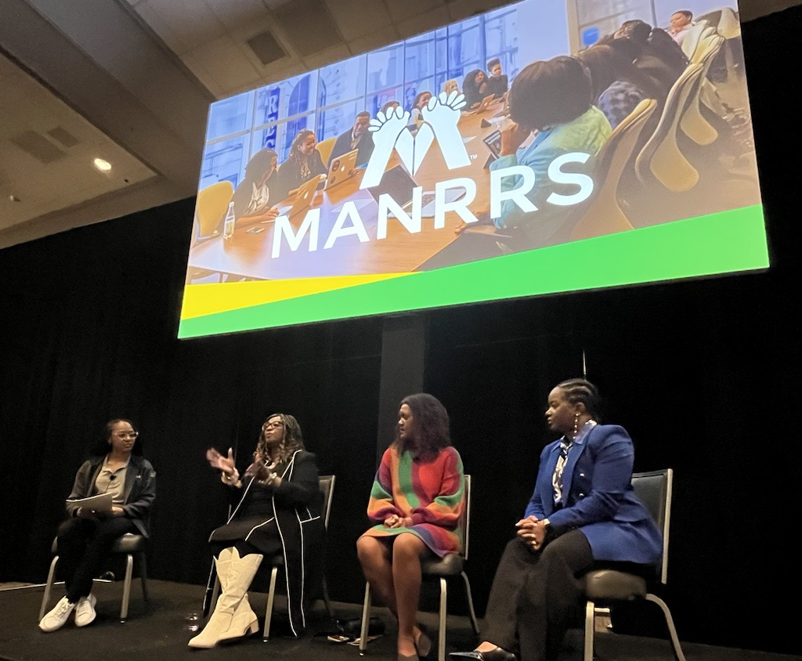
RMA SE Ambassador
Ambassador Outreach and Education - National Events and 1890 Land Grants: ​
    National Black Growers Council Annual Meeting
    USDA's 100th Annual Agricultural Outlook Forum
    Prairie View A&M College of Ag - Women In Agriculture Conference
    MANRRS 38th Annual Training Conference – Pre-Conference Summit
    1006 Technical Assistance Cooperator Network Meeting
    1890 Small Farmer Conferences and Field Days (Tentative)
      Florida A&M University, Tallahassee, FL
      North Carolina A&T University, Greensboro, NC
      Southern University, Baton Rouge, LA
      South Carolina State University, Orangeburg, SC
      Virginia State University, Petersburg, VA
    Federation of Southern Cooperatives Annual Meeting

Slide 14
Planting Confidence with Crop Insurance
    Custom Ag Solutions, LLC
  2-year national pilot with $1.9 million in FY 2023 funding
  Custom Ag Solutions (CAS) will work with RMA and numerous national-, state-, and local-level educational affiliates (e.g., FFA, 4H, Extension, and others) to improve future and beginning producer (BP) awareness and understanding of risk management concepts and tools.
  CAS will collaborate with RMA Subject Matter Experts to further enhance the web-based training platform, Farming is Risky Business (FRB) specifically with RMA products and programs. The platform provides lesson plans, content, and highly engaging simulation exercises.
  RMA will promote and target 100-200k Ag-Ed instructors, 4-H chapter leaders, and other educators to introduce BPs to an array of risk management and crop insurance topics through the training platform with a goal to reach 1M youth and BP.

Slide 15
Building Resiliency
Intertribal Agriculture Council (IAC)
  2-year pilot with $1.9 million in FY 2022 funding
  A collaborative pilot program with Intertribal Agriculture Council (IAC), Annie’s Project, Rural Coalition, and Alcorn State University leverages a diverse set of networks with historically underserved producers and ranchers
  The nucleus of this project is to educate and inform traditionally underserved communities about the possibilities of becoming crop insurance agents and adjusters within their communities and then to provide the mechanism, preparation, and provision to gain employment in the crop insurance sector; increasing the underserved representation of insurance agents and loss adjusters providing service to underserved producers
    Project will occur in three phases – Deliver a Training Program, Exam Preparation, and Career Development, including resume preparation, interview skills and host an Approved Insurance Provider Job Fair

Slide 16
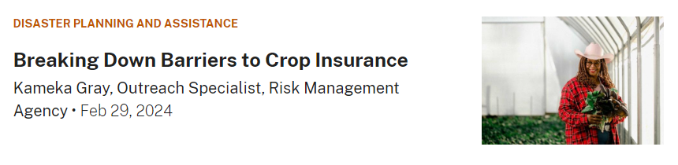
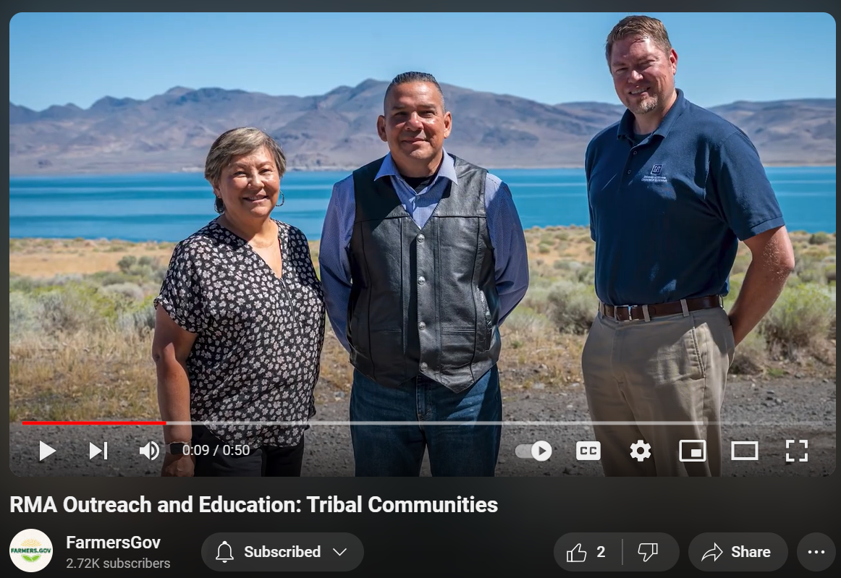
RMED Partnership Stories
Farmers.Gov Blog - Breaking Down Barriers to Crop Insurance
Farmers.Gov YouTube – RMA Outreach and Education

Slide 17
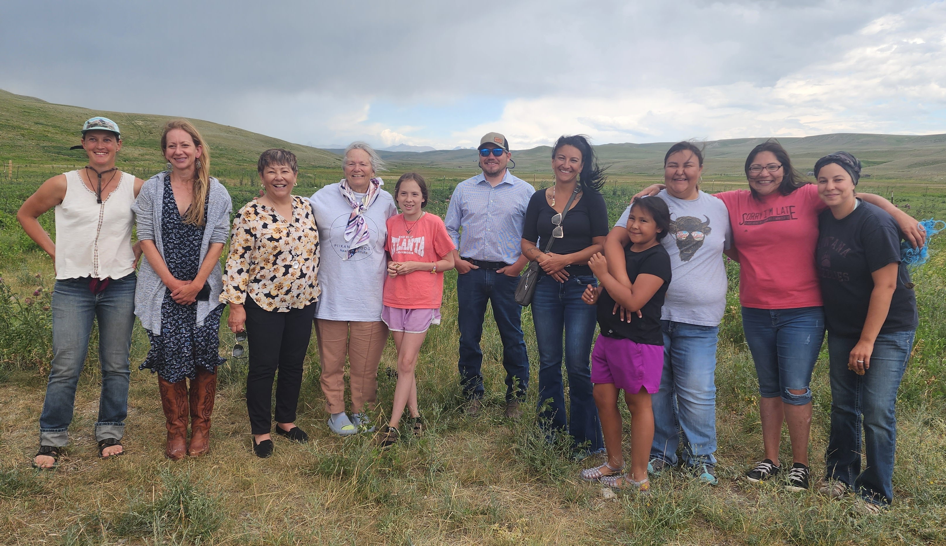
Questions? rma.risk-ed@usda.gov

