Slide 1



Risk Management Agency
NCBA Webinar – April 18, 2024

Slide 2
Federal Crop Insurance
Protects farmers against production and revenue losses from naturally occurring events – weather perils, insects, etc.
      Approximately 70% of losses are due to precipitation (flood/drought)
USDA-RMA serves as the regulator and reinsurer for private market sells and services insurance contracts.
Premiums for producers are subsidized by the Federal Government
  Varies by policy on average 62%
Largest permanent Farm Safety Net program
      $207 billion insured value in 2023, with over 600 crop varieties.

Slide 3
Federal Crop Insurance, cont.
    Crop Insurance Options Offered
  Multi-Peril Crop Insurance (MPCI), Actual Production History (APH) Coverage
  Whole Farm Revenue Protection (WFRP)
    Micro Farm
  Nursery and Nursery Value Select (NVS)
  Controlled Environment (CE)
  Livestock Risk Protection (LRP)
  Dairy Revenue Protection
  Pasture, Rangeland, Forage (PRF)
  Revenue Protection (RP)
  Yield Protection (YP)
  Shellfish

Slide 4
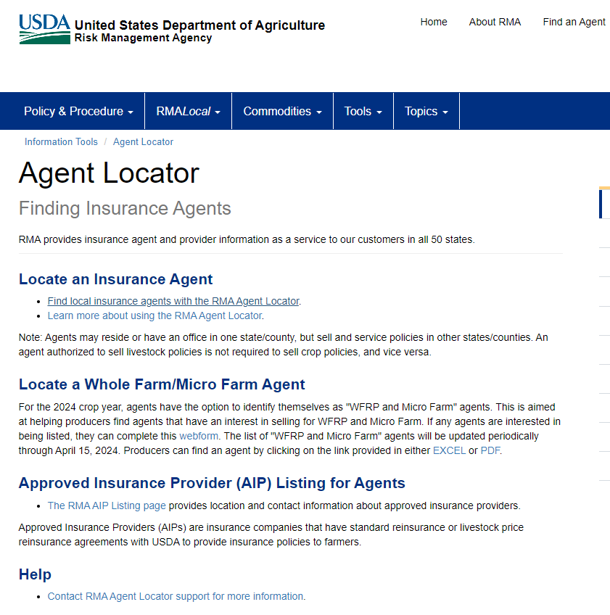
Getting Crop Insurance
RMA
Agent Locator Tool
Agent Locator | RMA (usda.gov)
RMA cannot recommend one agent over
another.
Use RMA’s Agent Locator Tool to find a
Crop insurance agent near you.
Alternatively, find an agent through your
network. Consider asking other farmers
to recommend and agent.
Meet with the agent to learn about crop insurance products that could work well for your farm.

Slide 5
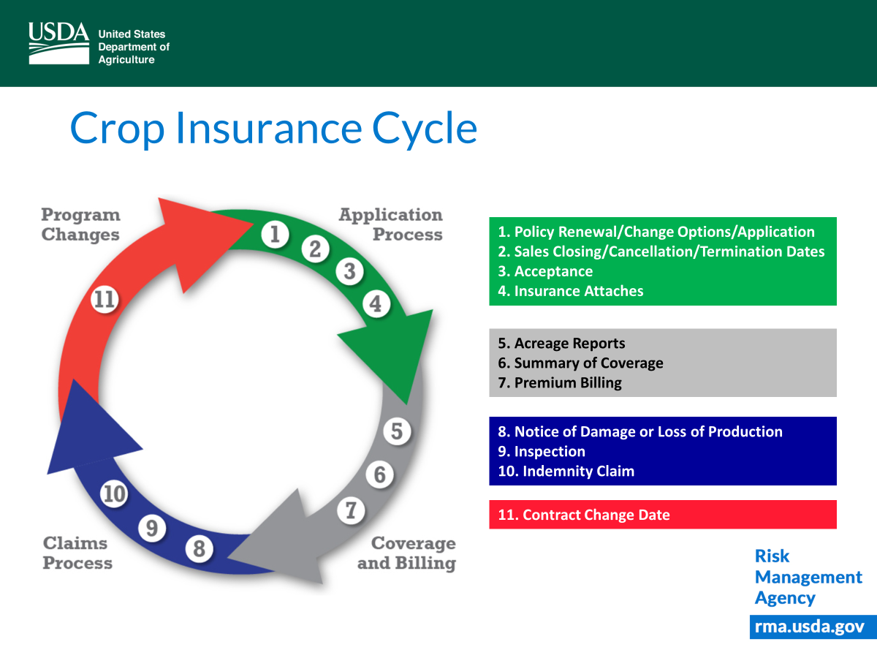

Slide 6
Crop Insurance
Beginning/Veteran Farmer and Rancher Benefits
What benefits are available?
Exemption from administrative fees for catastrophic and additional coverage policies
Reduced cost for additional coverage policies through an additional 10 percentage points of the premium subsidy
Use of another person’s production history for the specific acreage transferred to the BFR or VFR if they were previously involved in decision making or physical activities on any farm that produced a crop or livestock
An increase in the substitute Yield Adjustment
How long do benefits last?
Up to 5 years, as long as you still qualify as a beginning/veteran farmer (10 years for Whole Farm Revenue Protection Program); or
You cancel your application.

Slide 7
Crop Insurance
Beginning/Veteran Farmer and Rancher Benefits
Who is a Beginning Farmer/Rancher?
For crop insurance benefits, someone who has not operated a farm or ranch for more than 5 crop years.
You may be able to exclude some years:
  If you were under 18 years old
  If you were enrolled in post-secondary studies
  If you were active duty in the military
Who is a Veteran Farmer?
For crop insurance benefits, a veteran who has not operated a farm or ranch for more than 5 years, or first
obtained veteran.

Slide 8
Whole-Farm Revenue Protection
And Micro Farm
What is Whole-Farm Revenue Protection (WFRP)?
It’s a crop insurance policy that helps protect your revenue when there is a loss.
Covers most crops. Ideal for specialty crop producers/diverse operation.
Available nationwide for farms with up to $17 million in revenue.
  Farms with $350,000 or less in revenue are eligible for the Micro Farm policy.
  Micro Farm is a simplified version of WFRP.

Slide 9

Application
Sales Closing Dates vary across
the United States; please check with
your agent or the Actuarial Information
Browser on the RMA Website.
Required Forms
  Farm tax records – Schedule F:
    WFRP- 5 years
    Micro Farm- 3 consecutive years
  Inspection may be required for perennials
  Allowable Revenue Worksheet
  Whole Farm History Report
  Intended Farm Operation Report

Slide 10
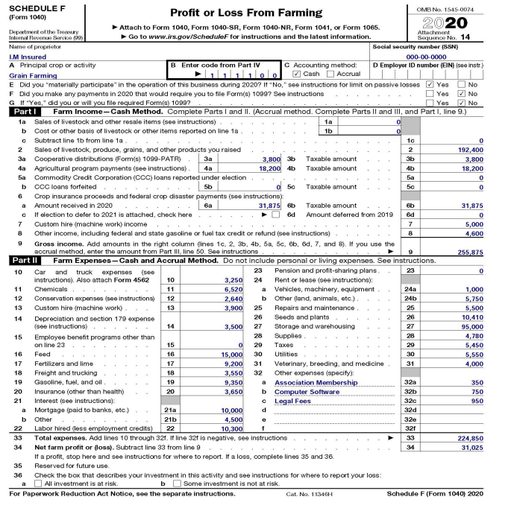
Schedule F

Slide 11
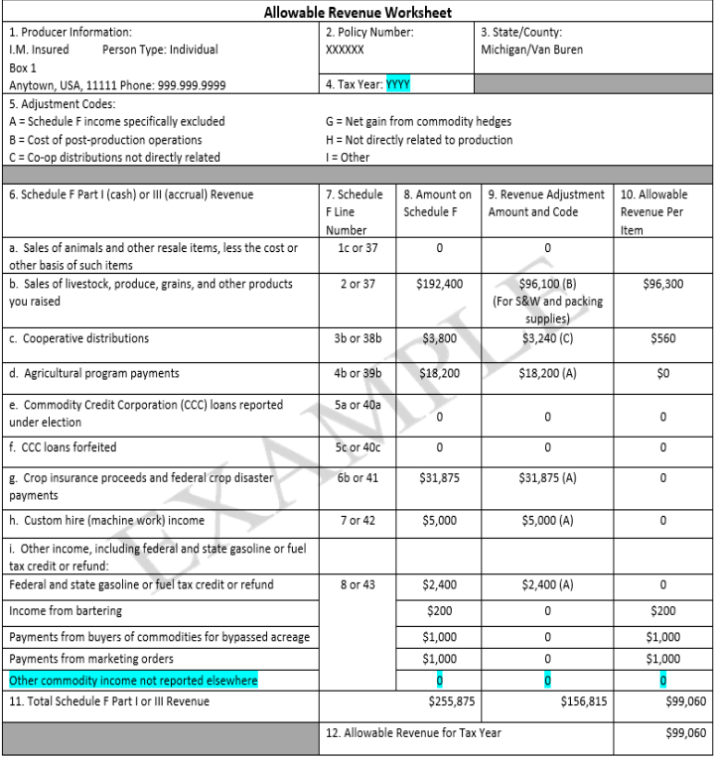
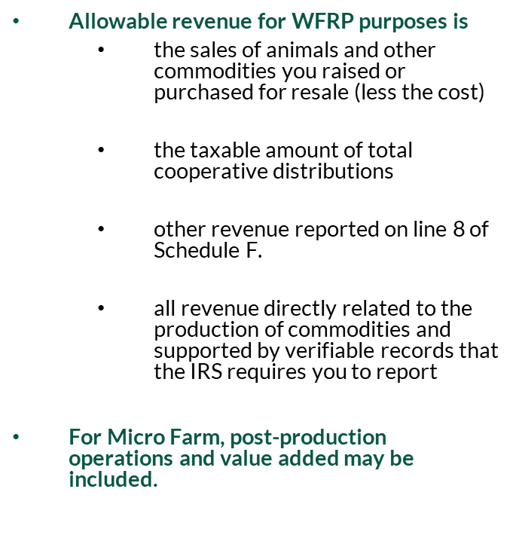
Allowable Revenue

Slide 12
Allowable Revenue
Notable Exclusions
  Any post-production operations
  Revenue earned from custom hire or rental activities;
  Revenue from wages, salaries, tips, and cash rent;
  Revenue from government programs, including NAP and Crop Insurance
  Revenue from uninsurable commodities, such as, animals for show or sport, timber, forest and forest products, and controlled substances;
Full list of exclusions in Section 10 of Policy

Slide 13
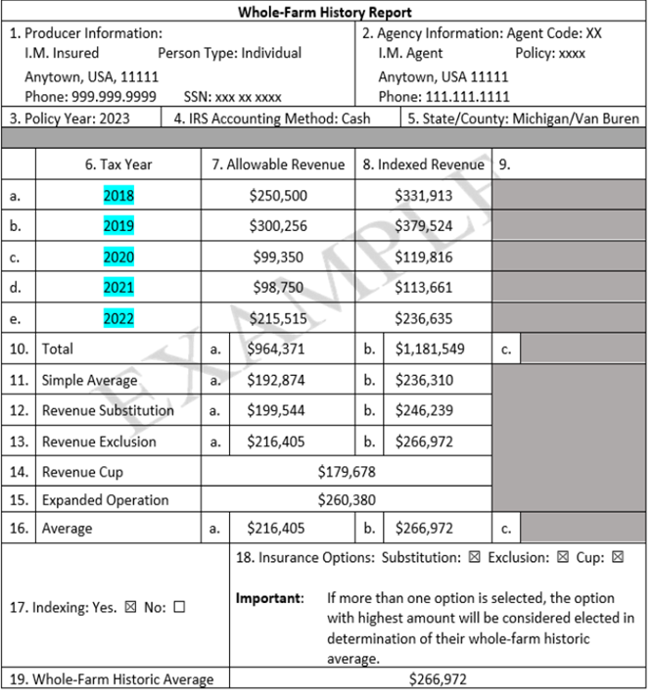
Whole Farm History Report
Based on Allowable Revenue Worksheet
  Contains Allowable Revenue for each year of the whole-farm history period.

Slide 14
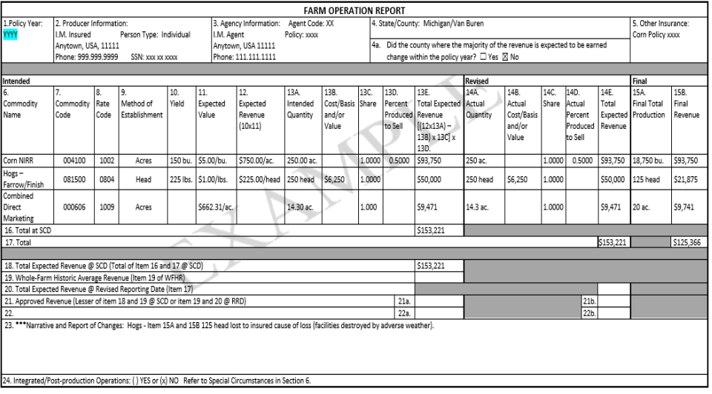

Farm Operation Report
Includes all commodities for which you expect to earn insurable revenue
Revenue is based on expected yields and expected values unique to each operation
  Supported by Expected Value and Yield Worksheet
Commodities that are direct marketed can be combined

Slide 15
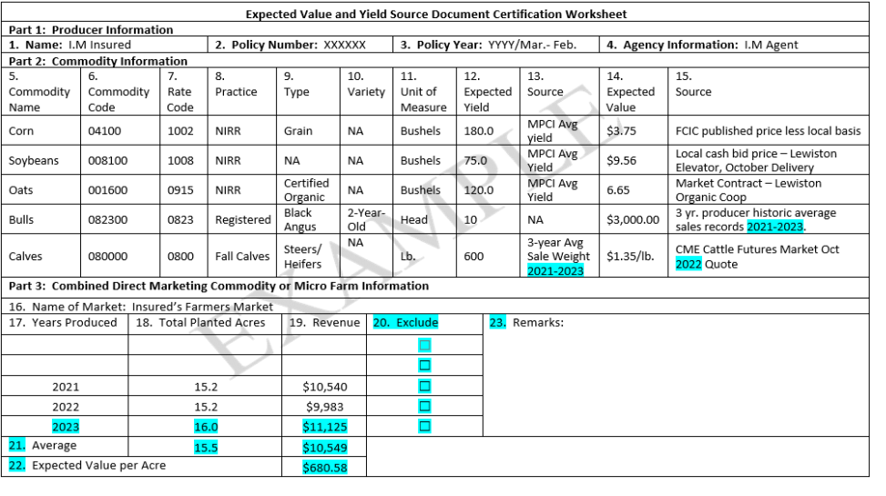
Expected Value and Yield

Slide 16
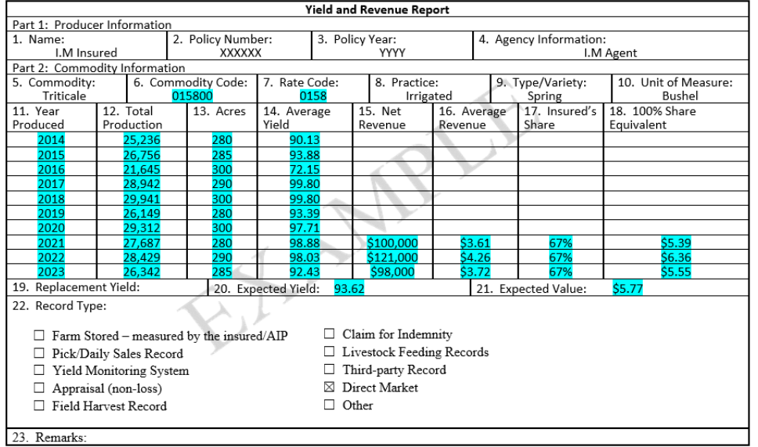
Yield and Revenue Report

Slide 17
Third Party Verifiable Records
Verifiable records must be provided to support forms and contain the following elements
  Name of seller;
  Commodity;
  Practice, type, or variety, if applicable;
  Intended use of a commodity having significantly different expected values;
  Name of buyer;
  Date and year of transaction.

Slide 18
Direct Marketing Records
Direct marketers may not have records that are third party verifiable
Direct marketer records should include:
  Insured’s name;
  date;
  name of the market, website, or buyer, as applicable;
  total cash receipts;
  commodities sold
Insurance companies may request contemporaneous records as well

Slide 19
Acreage Report
WFRP & Micro Farm
  July 15
Required forms:
  Revised Farm Operations Report

Slide 20

Revised Farm Operation Report
*Same sample form, but revised to reflect growing season changes

Slide 21
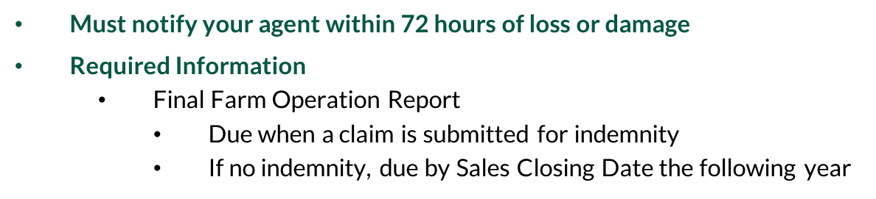
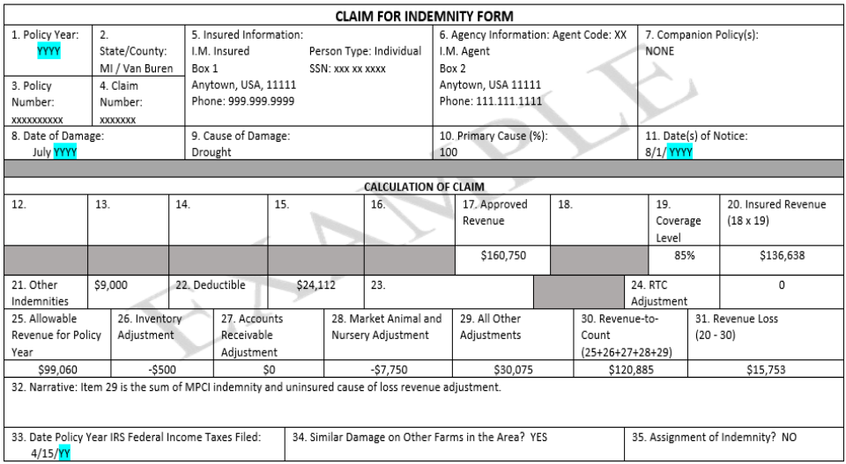
Claim Form

Slide 22
Premium Billing
WFRP & Micro Farm
  August 15
How much does the program cost?
  It depends on your operation
  Varying rates and subsidies
  When crop diversity increases, cost to producer decreases
RMA Cost Estimator:
  https://ewebapp.rma.usda.gov/apps/
  costestimator/

Slide 23

Whole-Farm Revenue Protection
Why purchase crop WFRP?
Example:
A vegetable farmer has a WFRP policy.
The farmer makes less revenue this year compared to past years.
  There was a hailstorm that destroyed part of the crop.
  And irrigation water supply failed during a drought.
The farmer receives a payment to cover a portion of the loss depending on the amount of insurance they purchased.
The farmer has enough money to still pay themself a wage.
And Micro Farm

Slide 24
Whole-Farm Revenue Protection
And Micro Farm
Some tips for finding a crop insurance agent.
Not all crop insurance agents feel qualified selling WFRP.
A database is available from RMA listing the agents who self-identified as actively want to sell these policies to growers.
WFRP/Micro Farm Agent database can be found using either of these links.
rma.usda.gov/Information-Tools/Agent-Locator
rma.usda.gov/Topics/Specialty-Crops

Slide 25
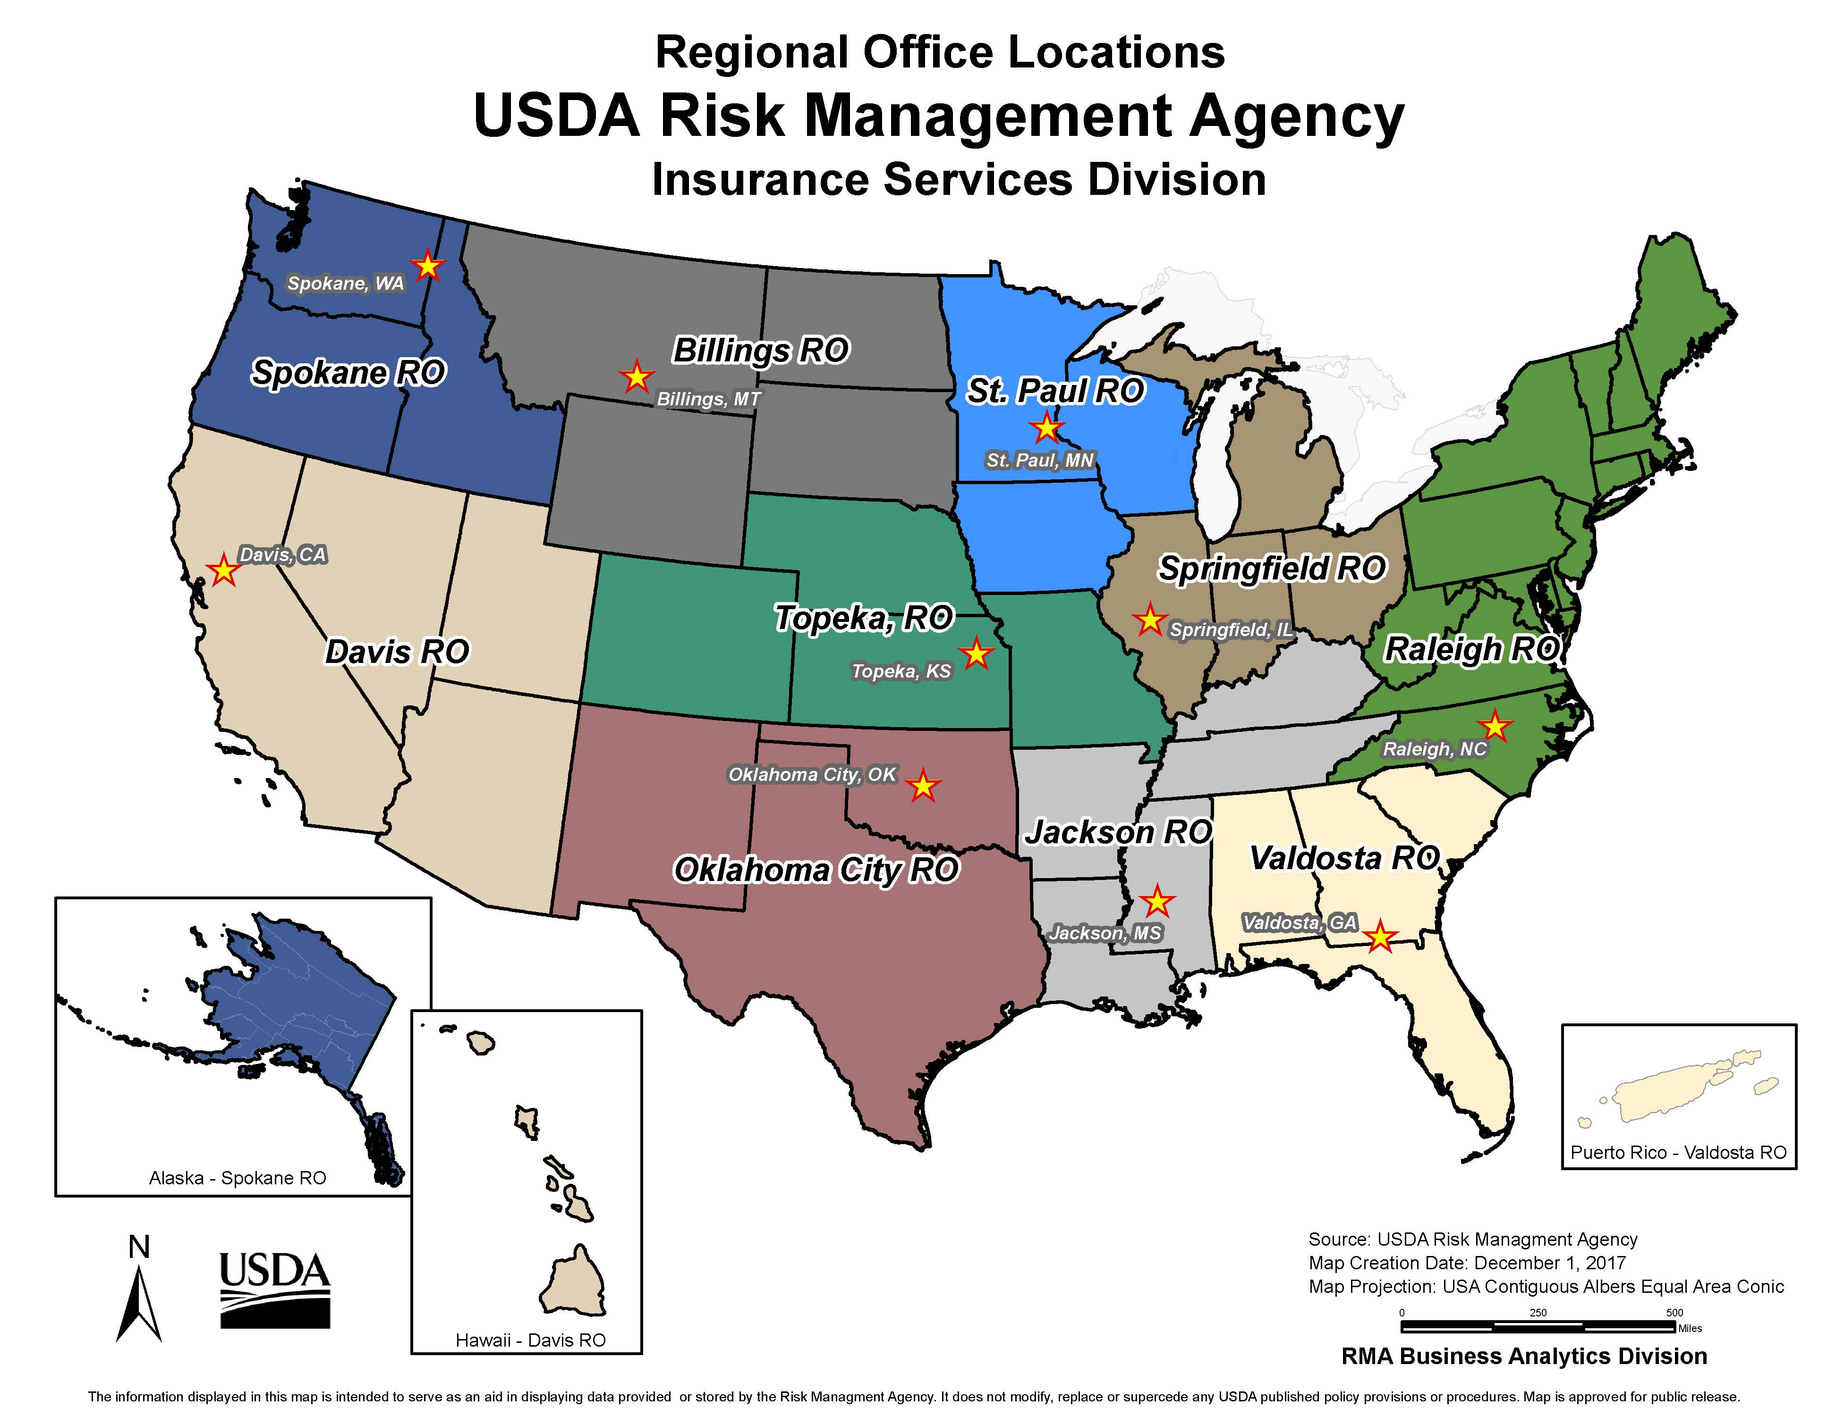
Appendix – Regional Offices

