Slide 1
The USDA Rural Energy Savings Program
Innovative Partnerships and Expanded Energy Efficiency Measures
National Cooperative Business Association
April 8, 2021

Slide 2
Agenda
The Rural Utilities Service (RUS)
RUS Electric Program
Overview of the Rural Energy Savings Program (RESP)
Success Stories

Slide 3




RUS makes loans and loan guarantees in rural areas for the following systems.
Broadband 2002
Water and Wastewater 1937
Electric 1935
Telephone 1949

Slide 4
RUS – Electric Program
  RUS makes loans and loan guarantees for electric power systems construction, improvements and replacements aimed at furnishing or improving the electric service in rural areas.
  The Electric Program serves approximately 610 borrowers and grantees in 46 states.
  Relending for energy efficiency investments (EECLP, RESP).

Slide 5





RESP Overview
RUS
Loan @ 5% or less for up to
10 years.
0% for up 20 years.
$
Eligible Borrower
Consumer for EE Measures @ qualified consumer’s facilities
Manufactured home energy efficiency retrofit or full replacement
(cost effectiveness required)

Slide 6
RESP Fundamentals

Slide 7
RESP Purpose
Help rural families and small businesses achieve cost savings by providing loans to qualified consumers through eligible entities to implement durable cost-effective energy efficiency measures, energy storage, and renewable energy technologies.
RUS Direct Loan to Borrowers so that they can relend to their consumers for energy efficiency investments, energy storage and renewable energy technologies.
*Rural means any area that has a population of 50,000 or less inhabitants or any other area designated eligible by statute.

Slide 8
Who Can be a RESP Borrower?
any public power district, public utility district, or similar entity, or any electric cooperative that borrowed and repaid, prepaid, or is paying an electric loan made or guaranteed by RUS;
any entity primarily owned or controlled by 1 or more entities described above; or
any other corporations, states, territories, and subdivisions and agencies thereof; municipalities; people's utility districts; and cooperative, nonprofit, limited-dividend, or mutual associations that provide or propose to provide eligible purposes under RESP, including energy efficiency, renewable energy, energy storage or energy conservation measures and related services, improvements, financing, or relending.

Slide 9
Program Evolution
Agricultural Act of 2014
(Farm Bill)
Agricultural Improvement Act of 2018
7 CFR Part 1719 (Program Regulation)
April 2, 2020
Appropriations Acts of 2016 and 2018
Notices of Solicitations for Applications
Current Status = Open
NOSA Released (12/15/20)

Slide 10
2018 Farm Bill Amendments
added on- or off grid renewable energy to the list of eligible energy efficiency measures;
added energy storage systems to the list of eligible energy efficiency measures;
Directed the Agency to not to include RESP debt in the calculation of debt-equity ratios for the purpose of determining eligibility to borrow under the Rural Electrification Act;
Instructed the Agency to develop streamlined accounting requirements;
Increased from 3% to 5% in the maximum permitted interest rate that can be charged by a borrower to a qualified consumer;
Allowed for qualified consumer repayment of RESP loans to RESP borrowers via a recurring service bill; and
Required the Agency to periodically publish RESP award data.

Slide 11
Consolidated Appropriations Act of 2021…
…The Secretary may allow eligible entities, or comparable entities that provide energy efficiency services using their own billing mechanism to offer loans to customers in any part of their service territory and to offer loans to replace a manufactured housing unit with another manufactured housing unit, if replacement would be more cost effective in saving energy.
FY 2021 Budget Authority is $11 Million available until expended.

Slide 12
RESP Evolution: Funding the Program
NOSA/NOFA Publication | Period Covered | Funding Sources | Highlights
June 2016 | 2016 | Consolidated Appropriations Act, 2016, Division A, Title VII, Section 744 | First appropriation.
November 2017 | 2017 | Consolidated Appropriations Act, 2017, Title III, Section 769 | Funding authority remained the same.
August 2018 | 2018 & 2019 | Consolidated Appropriations Act, 2018, Division A, Title VII, Section 741 | eligible entities to offer loans to customers in any part of their service territory Offer loans to replace a manufactured housing unit with another manufactured housing unit, if replacement would be more cost effective in saving energy
April 2020 | 2020 | Further Consolidated Appropriations Act, 2020, Division B, Title VII, Section 732 | eligible entities or alike that provide EE services using their own billing mechanism to offer loans to customers in any part of their service territory offer loans to replace a manufactured housing unit with another manufactured housing
December 2020 | FY 2021 | Current approximate program funding Level | Greater than $100 Million

Slide 13
FY 2020 Letters of Intent Received
17 LOI’s received before 9/30 totaling $146 Million.
12 applicants invited to proceed with loan application.
Average loan request now $8 million.
Non-traditional RUS borrowers showing interest in the program (Only 2 were existing borrowers!).
New applicant types:
  Green Banks
  State Energy Offices
  Municipalities
  Other Utilities (gas, water)
  State Sponsored EE non-profit entities

Slide 14
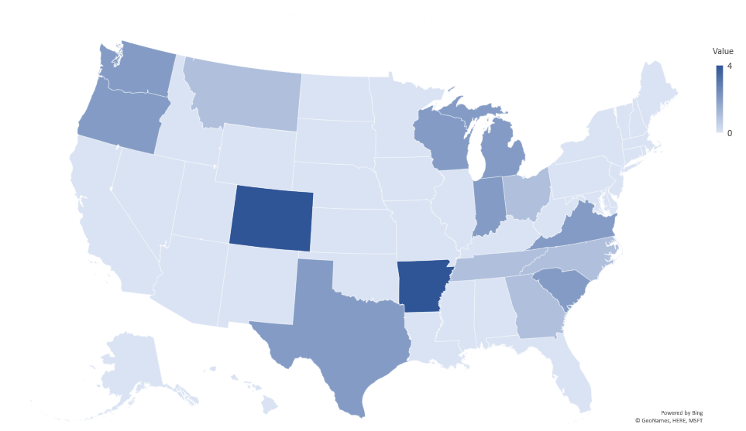
Participating States
Arkansas | 4
Colorado | 4
Georgia | 1
Indiana | 2
Michigan | 2
Montana | 1
North Carolina | 1
Ohio | 1
Oregon | 2
South Carolina | 2
Tennessee | 1
Texas | 2
Virginia | 2
Washington | 2
Wisconsin | 2

Slide 15
Program Profile
As of FY2020, 29 approved loans.
Approved loan sizes range from $150k to $50 Million.
Approved average loan size $6.3 Million.
Approved loans with significant renewable energy elements increasing.
One full manufactured home replacement loan for energy efficiency made to an electric cooperative.

Slide 16
Program Profile- Evolution of RESP Average Loan Size

Slide 17
RESP Application Process
Letter of Intent
Complete Application
Conditional Commitment Letter
Open until Funds Expended Each Fiscal Year
90 days
RUS Application Review
Intent To Meet Conditions
(60 Day response)
RUS
Pre screening
RESP Borrower
Applications
(by invitation only)
Publication of NOSA
Applicants

Slide 18
RESP Eligible Activities (Energy Efficiency Measures)
  Lighting Improvements (Residential and commercial)
  HVAC Systems
  Building Envelope Improvements
  Water Heaters
  Compressed Air Systems
  Motors
  Boilers, Dryers, Heaters and process related equipment
  Energy Audits
  On or Off Grid Renewable Energy Systems
  Energy Storage Devices
  Energy Efficient Appliance Upgrades (fixed to real property)
  Irrigation or Water and Waste Disposal System Efficiency Improvements
  Replacement of Manufactured Homes
  Electric Vehicle Chargers in behind the meter applications
  Other Approved Activities and investments directly related to
  Energy Efficiency Implementation

Slide 19
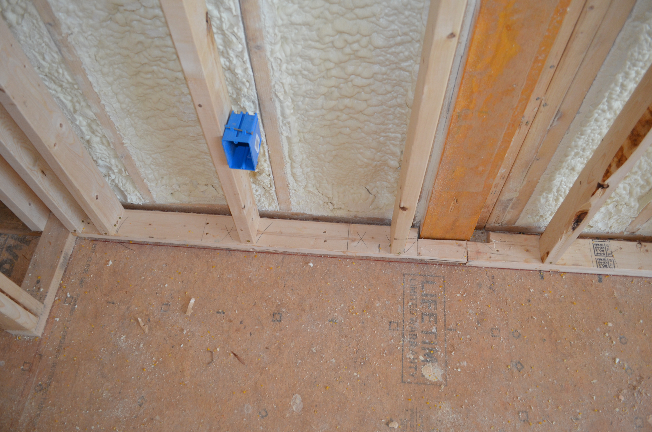
New Eligible Activities
Vehicle Chargers (behind the meter)
Smart Devices (Thermostats, Appliances (attached), etc.)
Cost-effective energy storage systems
Cost-effective on or off-grid renewable energy
Sometimes - Replacement of Manufactured Homes with more efficient MH

Slide 20
Measurement and Verification
5 Techniques for M&V in RESP:
  Retrofit Isolation with Key Parameter (component level);
  Retrofit Isolation with All Parameter (measurements of baseline and post-retrofit use);
  Whole Facility Measurement (baseline and post-retrofit period);
  Calibrated Simulation (computer simulations with actual billing data); and
  Deemed Savings values and calculations (based on available TRMs, other sources).
Based on generally accepted principles, best practices, and reasonable assumptions.
Nature, scope and complexity will dictate level of effort.
Value of information provided by the M&V is appropriate to the value of the project.
Balance uncertainty with cost.

Slide 21
Examples of successful RESP loan applications

Slide 22
Representative Program- Small Business EE Program
Microloans to eligible small commercial customers to implement EE improvements
Loan sizes from $5,000-$100,000
RUS borrower works with a partner for loan processing, underwriting, closing, and servicing but loan approval remains with the RUS borrower.
Loan terms:
  Not to exceed 10 years
  3% fixed interest rate
  25% equity of eligible project costs
  15% minimum energy savings supported by energy audit
60 days estimated timeframe for closing the loans with the RUS borrower’s consumer.

Slide 23
Representative Programs- On-Bill Tariffed Financing
It is optional and voluntary for the electric cooperative’s members.
Available to residential, small commercial members of the electric cooperative and to the building owner of any structure occupied by an existing co-op rental member.
The Program Operator or EE contractor performs a cost effectiveness analysis & identify the recommended EE measures to improve EE to lower costs to the member.
The electric cooperative recovers the cost of the investments in EE measures through a monthly charge assigned to the meter at the location where the upgrades were installed until the cost is recovered. Future occupants will pay for the upgrades until the cost is recovered.
The charge for energy efficiency investments is considered an essential part of the consumer’s bill for electric service.
Project size: $1,000-$25,000

Slide 24
Representative Program: Residential EE Program
Implemented by a non-profit on behalf of several participating electric cooperatives
Loan loss reserve: 1%
Loan size to qualified consumers approx. $10,000 @ 3% annual rate.
Loans will be made to homeowners & renters with the consent of their landlord.
Loan payments are recovered by on-bill charges on the electric bills.
Energy savings tracked for each unit comparing pre and post retrofit energy use. (Baseline is then weather normalized).
Significant amount of manufactured housing units within the service territory of participating electric cooperatives.
If a preliminary screening shows the electric coop member would likely benefit from EE investments, then an energy audit is performed, and a set of EE recommendations are provided to the member.

Slide 25
RESP Success Stories

Slide 26
Success Stories From Our Borrowers -
Umatilla Electric Cooperative (Oregon)
UEC’s energy efficiency loan program, over 10
years from 2009-2018, made 23 loans at 5%
interest.
UEC’s RESP “Energy Saver Loan” program has made
70 loans at 1.99% in the two years since the program
began in January 2019. About $500,000 has been
loaned to members for heat pumps, windows and
insulation.
Why the greater interest?
On-bill financing makes it easier for members to apply and be qualified. 88% of loan applicants are approved, based on their bill payment history, and if that’s a bit shaky, a review of their credit report. We have had no member loan defaults since we began RESP.
Most of our participants have been referred by HVAC installers. (Rather than advertising.) The program helps installers provide heating and cooling to more customers, and they are quick to refer customers to us for financing.
Used by permission of Umatilla Electric

Slide 27
Success Stories From Our Borrowers –
Umatilla Electric Cooperative (Oregon)…
“After my new HVAC system was installed, I could tell the difference in the house in just a few minutes. With your (Energy Saver) loan, you’re helping people to be happy and prepared for all kinds of weather without the worrying of a very big payment when getting a new system.”
Used by permission of Umatilla Electric

Slide 28
Success Stories From Our Borrowers –
PeeDee Electric (NC)
PeeDee was one of the first RESP Loans (Obligated July 2017).
Eligible Activities centered on weatherization and Energy Efficiency.
Most consumer loans were the direct result of marketing the program to their members.
Used by permission of PeeDee Electric of North Carolina

Slide 29
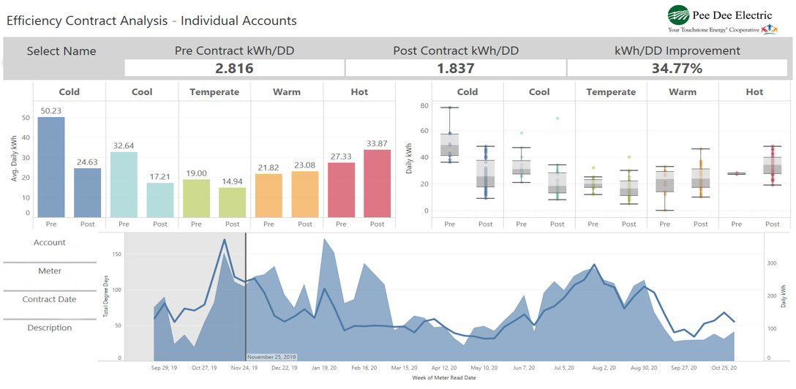
Success Stories From Our Borrowers –
PeeDee Electric (NC)
Used by permission of PeeDee Electric of North Carolina

Slide 30
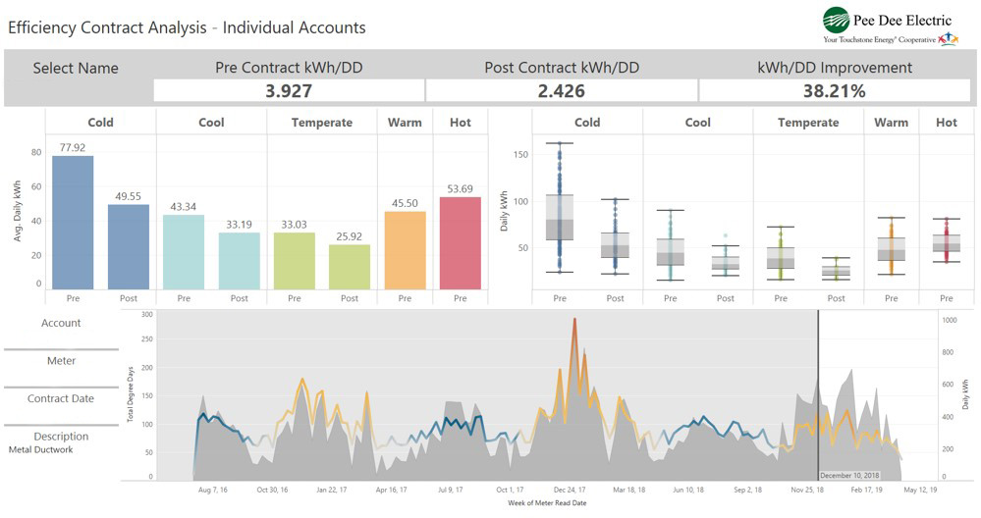
Success Stories From Our Borrowers –
PeeDee Electric (NC)
Used by permission of PeeDee Electric of North Carolina

Slide 31
Lessons Learned from KW Savings’ Help My House Model
Five years after the Help My House pilot, participating homes continued to demonstrate average savings of more than 30 percent with less than one percent degradation in those savings since measures were first installed.
Demand savings closely tracked energy savings despite the absence of demand controls.
Energy efficiency is likely to cost less than 2 cents per kWh compared to new generation, which will cost much more.
A 2010 pre-pilot analysis indicated a full-scale, state-wide version of Help My House could retrofit more than 225,000 cooperative-served homes and would stave off the need for more generation at a fraction of the cost of new power plants.

Slide 32
Success Stories From Our Borrowers - KW Savings
Help My House Model Duck Curve Improvement
Average Summer Day Load Shape
Kilowatt Hours (Kwh)
Hour

Slide 33
USDA- Rural Development
Together, America Prospers
  Who is your Point of Contact at USDA?
  Rural Development State Directors:
  https://www.rd.usda.gov/contact-us/state-offices
  Electric Program Contact Information:
  https://www.rd.usda.gov/programs-services/all-programs/electric-programs
  Electric Program General Field Representatives (GFR’s):
  https://www.rd.usda.gov/contact-us/electric-gfr

Slide 34
Acknowledgement and Disclaimer
Information included in this presentation is for illustration purposes only. USDA-RUS does not endorse or recommend any commercial entities, products, processes, or services. USDA-RUS is not responsible for the operation of the energy efficiency programs mentioned in this presentation and does not endorse, warrant, or guarantee the products, services, or information directly or indirectly described or voluntarily offered by the energy efficiency program operators.

Slide 35

Questions?
RUS Electric Program GFR Link: https://www.rd.usda.gov/contact-us/electric-gfr
USDA Rural Energy Savings Program Link:
https://www.rd.usda.gov/programs-services/rural-energy-savings-program
Contact Information :
Bob Coates PE, PMP
Electric Program
Rural Development, Rural Utilities Service
Robert.Coates@usda.gov
Office: (202) 260-5415
www.rd.usda.gov
Together, America Prospers

